Slide 1
Unit 3: Stack
Prepared by
Gobinda Subedi
For BIT, KIST

Slide 2
Introduction to Stack
A stack is an ordered collection of items into which new items may be inserted and from which items may be deleted at one end, called the top of the stack. The deletion and insertion in a stack is done from top of the stack. At any given time, we can only access the top element of a stack.
It is named stack as it behaves like a real-world stack, for example – a deck of cards or a pile of plates, etc.

Slide 3
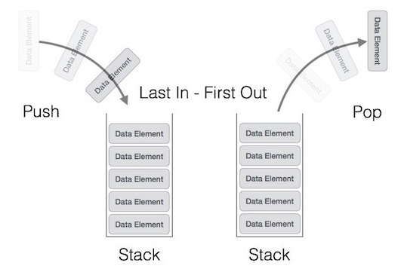
Stack Representation

Slide 4
Stack Operations
The following operations can be performed on a stack:
PUSH operation:
The process of putting a new data element onto stack is known as a Push Operation.
When we add an item to a stack, we say that we push it onto the stack The last item put into the stack is at the top of the stack

Slide 5
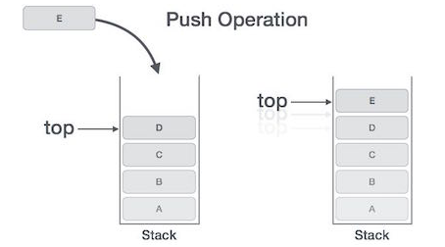
Push Operation

Slide 6
Push Algorithm
Let Stack[MAXSIZE] be an array to implement the stack. The variable top denotes the top of the stack
1. [Check for stack overflow?]
if top=MAXSIZE-1 then
print “Stack Overflow” and Exit
else
Set top=top+1 [Increase top by 1]
Set Stack[top]:= item [Inserts item in new top position]
2. Exit

Slide 7
Stack Operations
POP Operation:
Accessing the content while removing it from the stack, is known as a Pop Operation. In an array implementation of pop() operation, the data element is not actually removed, instead top is decremented to a lower position in the stack to point to the next value. But in linked-list implementation, pop() actually removes data element and deallocates memory space.
When an item is popped, it is always the top item which is removed.

Slide 8
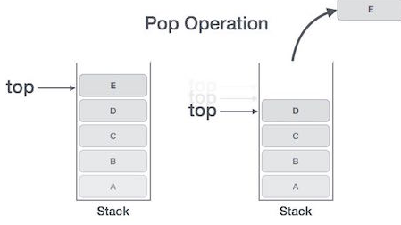
POP Operation

Slide 9
Pop Algorithm
Let Stack[MAXSIZE] be an array to implement the stack. The variable top denotes the top of the stack
1.[Check for the stack Underflow]
If top<0 then
Print “Stack Underflow” and Exit
else
[Remove the top element]
Set item=Stack [top]
[Decrement top by 1]
Set top=top-1
Return the deleted item from the stack
2. Exit

Slide 10
Other Basic operations
Apart from these basic following two primary operations −
push() − Pushing (storing) an element on the stack.
pop() − Removing (accessing) an element from the stack.
The following functionalities are added to make the stack efficient
peek() − get the top data element of the stack, without removing it.
isFull() − check if stack is full.
isEmpty() − check if stack is empty.

Slide 11
Stack Empty or Underflow:
This is the situation when the stack contains no element. At this point the top of stack is present at the bottom of the stack. In array implementation of stack, conventionally top=-1 indicates the empty.
Stack Full or Overflow:
This is the situation when the stack becomes full, and no more elements can be pushed onto the stack. At this point the stack top is present at the highest location (MAXSIZE-1) of the stack.

Slide 12
The Stack ADT:
A stack of elements of type T is a finite sequence of elements of T together with the operations
Push(S, x): Insert x at one end of the stack, called its top
Peek(S): If stack S is not empty; then retrieve the element at its top
Pop(S): If stack S is not empty; then delete the element at its top
IsFull(S): Determine if S is full or not. Return true if S is full stack; return falseotherwise
IsEmpty(S): Determine if S is empty or not. Return true if S is an empty stack; return false otherwise.

Slide 13
Implementation of Stack
Stack can be implemented in two ways:
Array Implementation of stack (or static implementation)
Linked list implementation of stack (or dynamic)
Array (static) implementation of a stack:
It is one of two ways to implement a stack that uses a one dimensional array to store the data. In this implementation top is an integer value (an index of an array) that indicates the top position of a stack. Each time data is added or removed, top is incremented or decremented accordingly, to keep track of current top of the stack. By convention, in C implementation the empty stack is indicated by setting the value of top to -1(top= -1).

Slide 14
isEmpty():
int isEmpty( int top)
{
if(top==-1) return 1;
Else return 0;
}
isFull():
int isFull(top)
{
if(top==MAX-1) return 1;
Else return 0;
}

Slide 15
Peek()
int peek()
{ return stack[top]; }// stack is the array.
Push(stack, data)
void push(int data)
{
if(!isFull())
{
top = top + 1;
stack[top] = data;
}
else
{
printf("Could not insert data, Stack is full.\n");
break;
}
}

Slide 16
Pop(data)
int pop(int data)
{
if(!isEmpty())
{
data = stack[top];
top = top - 1;
return data;
}
else
{
printf("Could not retrieve data, Stack is empty.\n");
}
}

Slide 17
Dynamic Implementation of Stack will be left until we study linked list

Slide 18
Representation of Arithmetic Expression
An Arithmetic expression contains operators and operands. Variables and constants are operands. The operators are of various kind such as arithmetic binary and unary and so on.
The precedence of operators also plays an important role in expression solving.

Slide 19
Infix, Prefix and Postfix Notations
In solving arithmetic expressions, we use stack because a stack is very useful to maintain the sequence of processing. A stack has various real – life applications.
We use three kinds of notations to express arithmetic expressions. These three kinds of notations are infix, prefix, and postfix. The prefixes pre, post, and in indicate the relative location of the operators between operands.

Slide 20
Infix, Prefix and Postfix Notations contd..
Infix Notation: It is an ordinary mathematical notation of expression where operator is written in between the operands. Example: A+B. Here ‘+’ is an operator and A and B are called operands.
Prefix notation: In prefix notation the operator precedes the two operands. That is the operator is written before the operands. It is also called polish notation. Example: +AB
Postfix notation : In postfix notation the operators are written after the operands so it is called the postfix notation (post mean after). In this notation the operator follows the two operands. Example: AB+

Slide 21
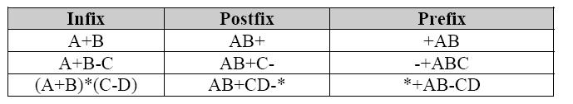
Infix, Prefix and Postfix Notations contd..
Both prefix and postfix are parenthesis free expressions. For example
(A + B) * C Infix form
* + A B C Prefix form
A B + C * Postfix form

Slide 22
Precedence rule
While converting infix to postfix you have to consider the precedence rule, and the precedence rules are as follows
1. Exponentiation ( the expression A^B is A raised to the B power, so that 3^2=9)
2. Multiplication/Division
3. Addition/Subtraction
When un-parenthesized operators of the same precedence are scanned, the order is assumed to be left to right except in the case of exponentiation, where the order is assumed to be from right to left.
A+B+C means (A+B)+C
A^B^C means A^(B^C)
By using parenthesis we can override the default precedence.

Slide 23
Precedence rule contd..
Consider an example that illustrate the converting of infix to postfix expression,
A + (B* C).
Use the following rule to convert it in postfix:
Parenthesis for emphasis
Convert the multiplication
Convert the addition
Post-fix form
Illustration:
A + (B * C). Infix form
A + (B * C) Parenthesis for emphasis
A + (BC*) Convert the multiplication
A (BC*) + Convert the addition
ABC*+ Post-fix form

Slide 24
Conversion of Expression
While doing the conversion operations, the following points are to be noted.
During conversion operations, it is essential that properties such as precedence, commutability, and well-formed expression of operations must be preserved.
The operations with high priority are converted first. The remaining part is considered as a single operand.
The variables must be in relative places. The operators are set according to precedence rules of operators.
A fully parenthesized infix expression, a conversion is started from innermost parenthesis to outermost parenthesis.
For converting an expression from infix to prefix the rules are same as for conversion from infix to postfix.

Slide 25
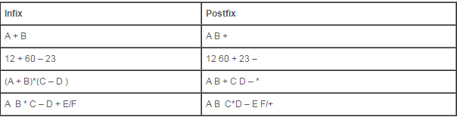
Conversion of Expression
Converting an Infix Expression to Postfix
Try yourself
(A + B) * ((C - D) + E) / F

Slide 26
Algorithm to convert infix to postfix notation
There two stacks opstack and poststack are used and otos & ptos represents the opstack top and poststack top respectively.
Scan one character at a time of an infix expression from left to right
Opstack & Poststack are the empty stack
Repeat till there is data in infix expression
if scanned character is ‘(‘ then push it to opstack
if scanned character is operand then push it to poststack
if scanned character is operator then
if(opstack!=-1)
while(precedence (opstack[otos])>precedence(scan character)) then pop and push it into poststack
otherwise
push into opstack
if scanned character is ‘)’ then
pop and push into poststack until ‘(‘ is not found and ignore both symbols
pop and push into poststack until opstack is not empty.
return

Slide 27
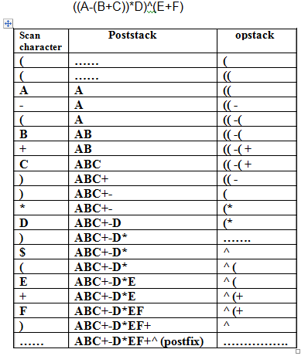
Tracing of Postfix Conversion Algorithm

Slide 28
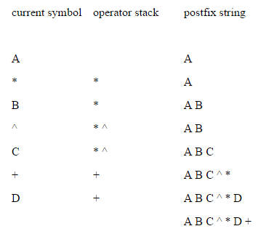
Trace of Postfix Conversion Algorithm
A * B ^ C + D becomes A B C ^ * D +

Slide 29
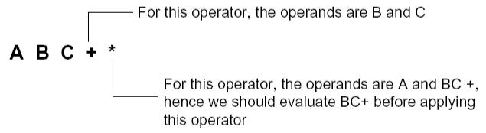
Evaluating the Postfix expression
Each operator in a postfix expression refers to the previous two operands in the expression.
Each time we read an operand we push it onto a stack. When we reach an operator, its operands will be the top two elements on the stack. We can then pop these two elements perform the indicated operation on them and push the result on the stack so that it will be available for use as an operand of the next operator.

Slide 30
Evaluating the Postfix expression
Consider an example
3 4 5 * +
= 3 20 +
= 23 (answer)
Try yourself
6 2 3 + - 3 8 2 / + * 2 ^ 3 +
= 52(answer )

Slide 31
Algorithm to evaluate the postfix expression
Here we use only one stack called vstack(value stack).
Scan one character at a time from left to right of given postfix expression
if scanned symbol is operand (or constant) then
read its corresponding value (if operand is variable)and push it into vstack
if scanned symbol is operator then
– pop and place into op2
– pop and place into op1
– compute result according to given operator and push result into vstack
2. pop and display which is required value of the given postfix expression
3. return

Slide 32
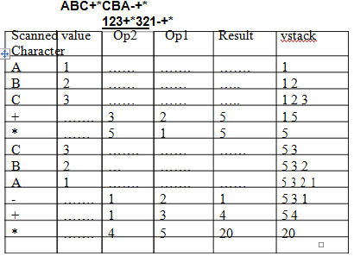
Tracing of Postfix Evaluation:
Consider an example to trace the postfix expression evaluation algorithm.

Slide 33
Converting an Infix expression to Prefix expression
The precedence rules for converting an expression from infix to prefix are identical. Only change from postfix conversion is that the operator is placed before the operands rather than after them. The prefix of
A+B-C is -+ABC.
Example Consider an example (Try yourself)
A ^ B * C – D + E / F / (G + H) infix form
=+-*^ABCD//EF+GH which is in prefix form. (Answer)

Slide 34
Evaluating the Prefix Expression
Consider an example for this:
+ 5 *3 2 prefix expression
= +5 6
=11
Try yourself
/ + 5 3 – 4 2
4 (Answer)

